Slide 1
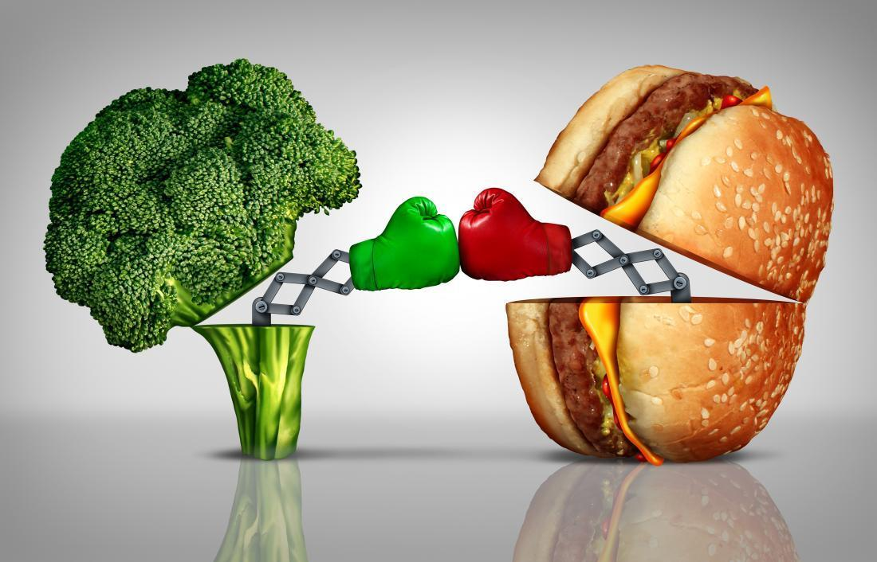
vegetarian
Versus
carnivore
classification

Slide 2
Executive Summary
Food is a uniquely important commodity, no one can avoid consuming it.
Foods are composed of plethora of substances, some of these we need, some we should avoid, others we should limit.
Different people have different needs for food substances, and different people have different tolerances for them.
Problem Statement
How might I better understand what is important to customers and their needs so that I can assist my marketing team to develop relevant products and services to better meet those needs.

Slide 3
Strategy
I am a data scientist working in a food industry company. My purpose of this project is to develop a classification model so that I can identify whether the user is a vegetarian or carnivore, as well as capturing the keywords of the conversations to determine trending topics.
Marketing strategy has moved from B2C method (companies create and sell products that they think the customers needs) to the C2B method (observing customers' behavior, listening and reviewing customers' comments and co-create new products).
Stakeholder
My main stakeholder for this project will be my company's marketing team whereby they can utilize the information to make better decision for new products and services.

Slide 4
Methodology
Problem Statement
Web Scraping
&
Data Collection
Evaluation
Data Massage
&
Preparation
EDA
Regularization
&
Classification
Misclassification Analysis
Conclusion
& Recommendation
- Logistic Regression
- Multinomial Naïve Bayes
- Random Forest
- Confusion Matrix
- ROC Curve and AUC

Slide 5
Data Source
Reddit is an American social news aggregation, web content rating and discussion website. It is a network of communities based on people's interests. I will be using the posts from Reddit website for my project.
Reddit – Vegetarian (https://www.reddit.com/r/vegetarian/)
Reddit – Carnivore (https://www.reddit.com/r/zerocarb)

Slide 6
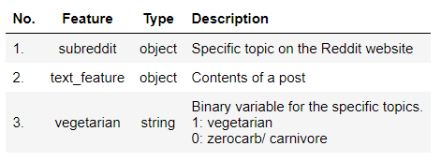
Data Cleaning & EDA
Remove duplicates in the dataframe
Replace null with empty string and combine ‘selftext’ and ‘title’
Engineer a feature to turn the subreddit into a 1/0 column, whereby 1 indicates vegetarian and 0 indicates zerocab.
2/3 of the data for training, 1/3 for testing.
Data Dictionary

Slide 7
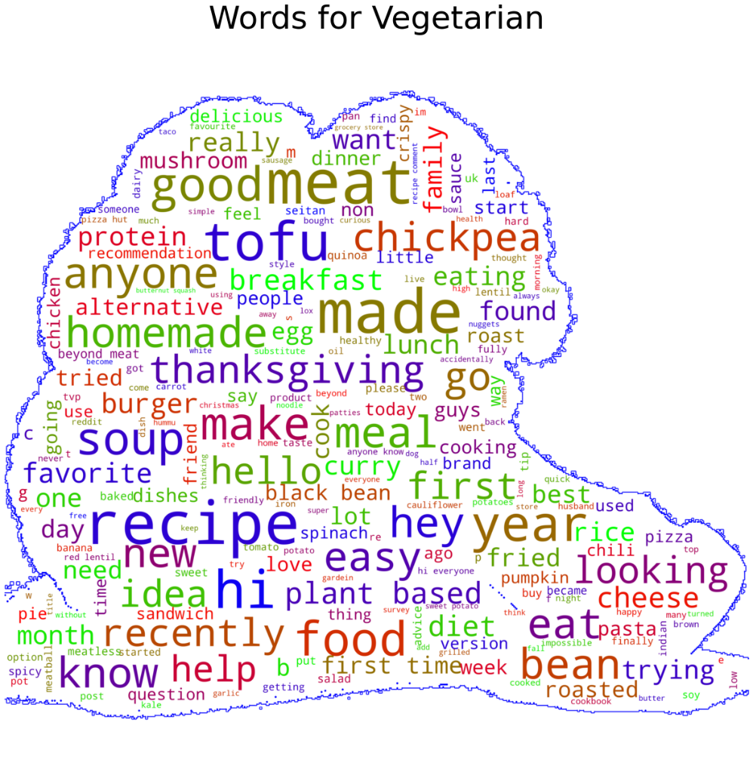
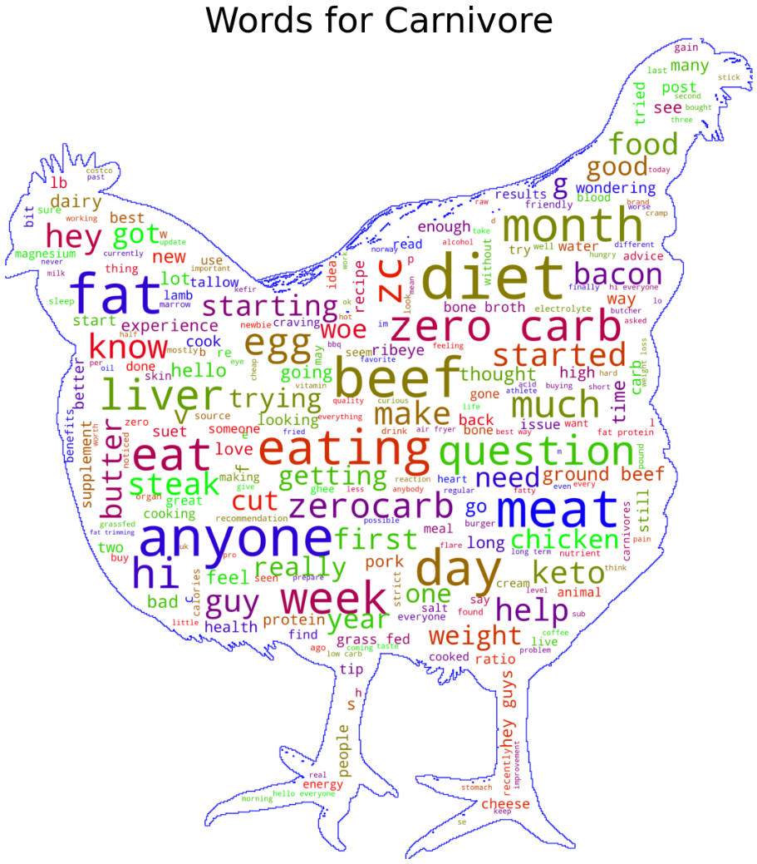
Cleaning and Pre-Processing
WordCloud

Slide 8
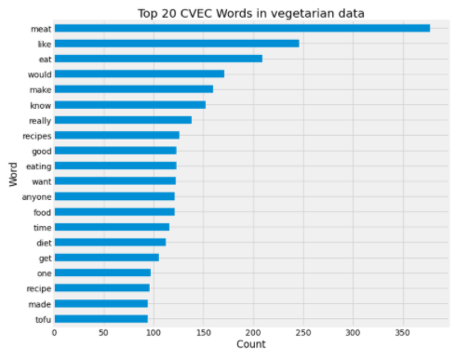
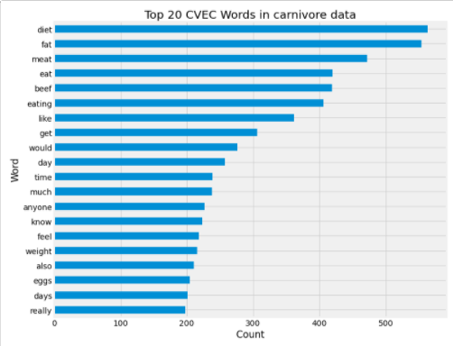
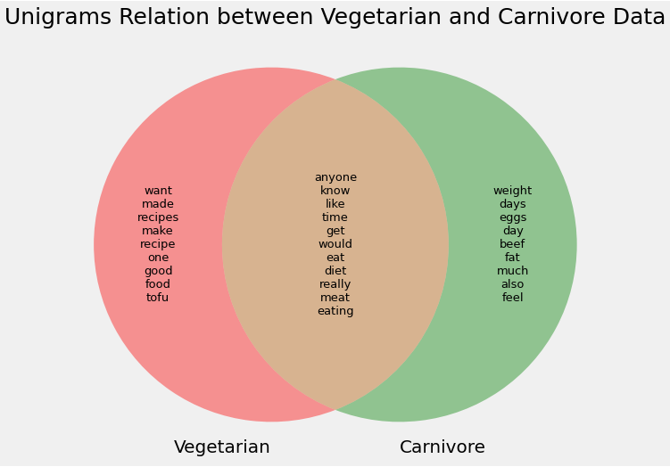
Cleaning and Pre-Processing
Bar Charts & Venn Diagram
After going through the wordclouds, bar charts and Venn diagrams, I have updated my stopwords list to remove the words that are not useful for the prediction and the words that are similar to the name of the target variables.

Slide 9
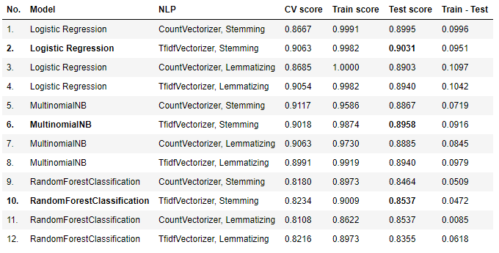
Regression and Classification: Results
All models are overfitted.
Selected best test score of each model for evaluation.

Slide 10
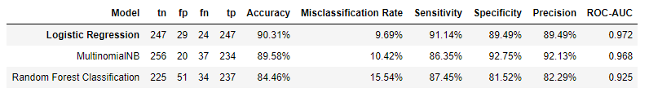
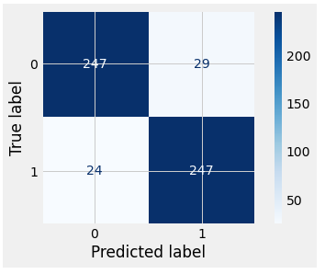
Evaluation: Confusion Matrix Results
My model correctly predicted 90.31% of observations (Accuracy)
My model incorrectly predicted 9.69% of observations (Misclassification rate)
For the posts of vegetarian, my model has correctly predicted 91.14% (Sensitivity)
For the posts of carnivore, my model has correctly predicted 89.49% (Specificity)
Among posts that are in vegetarian, my model has correctly predicted 89.49% (Precision)
TN
FP
FN
TP
0 - Carnivore
1 - Vegetarian

Slide 11
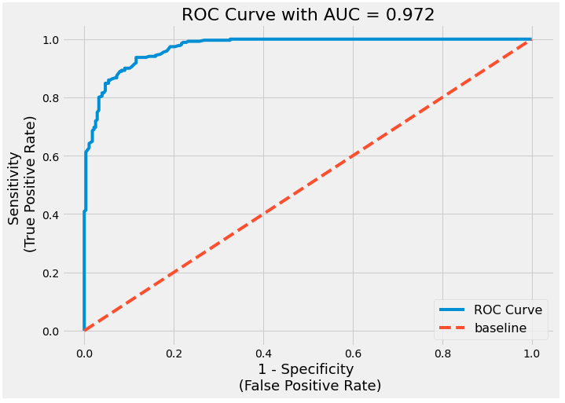
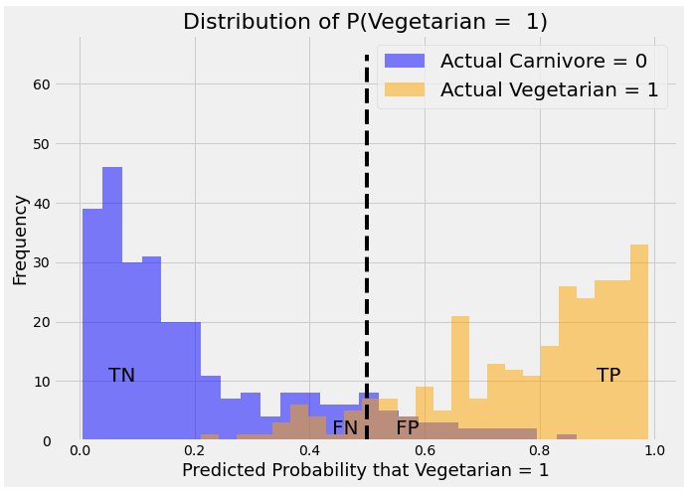
Logistic Regression Evaluation
- AUC- ROC curve tells how much a model is capable of distinguishing between classes. The higher the ACU, better the model is a predicting 0s as 0s and 1s as 1s.
- My ROC AUC is 0.972 which is closer to 1, which mean my model is a good classifier whereby positive and negative populations are almost perfectly separated.
Predicted Probability that
Vegetarian = 1 Carnivore = 0

Slide 12
Misclassification Analysis
False Positive Example
False Negative Example
When text with coefficient >=1, it is under group 1 (vegetarian)
When text with coefficient <1, it is under group 0 (carnivore)

Slide 13
Conclusion
From the analysis, Logistic Regression model has successfully solved my problem statement because it has the highest test accuracy (90.31%) of the prediction with lowest combination of false positive (29) and false negative (24) values.
The accuracy of the model, low values of false positive and false negative are important to my analysis because I want to correctly interpret the customers' information so that my company can better serve their needs.
Recommendation
1. Classifier model : Different classifiers can be used and their performance can be evaluated to find better predictions. Tuning of parameters would also help to get a better predictions.
2. NLP : Optimize the stop words and explore different NLP methods that generate the root form of the inflected words in order to improve the text classification accuracy.
3. Data : Scrape and collect more data for a better prediction, such as getting information from different blogs or social media.

Slide 14
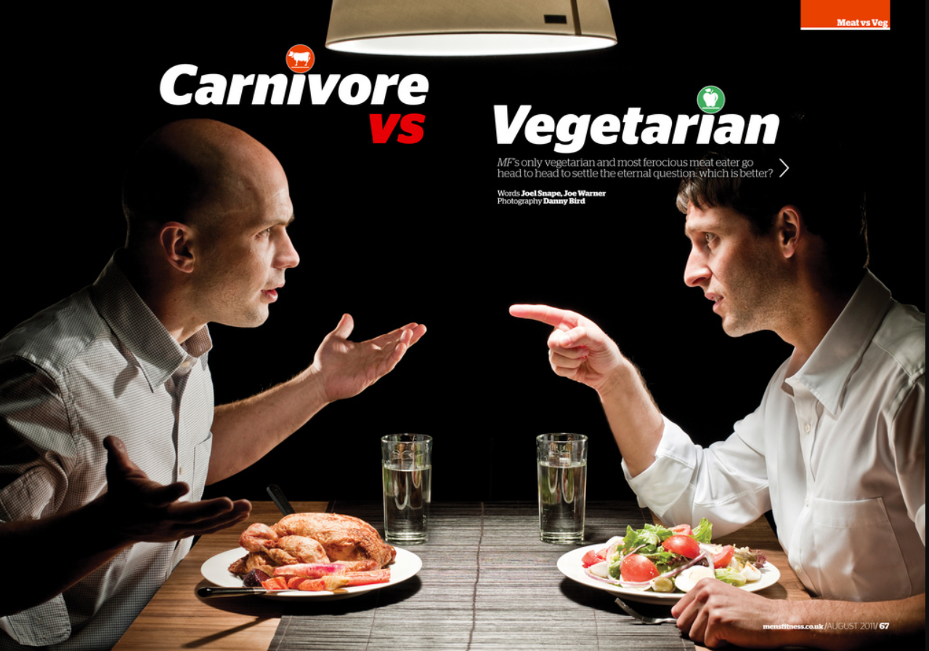
THANK YOU FOR YOUR TIME!!!
QUESTIONS??

